Slide 1
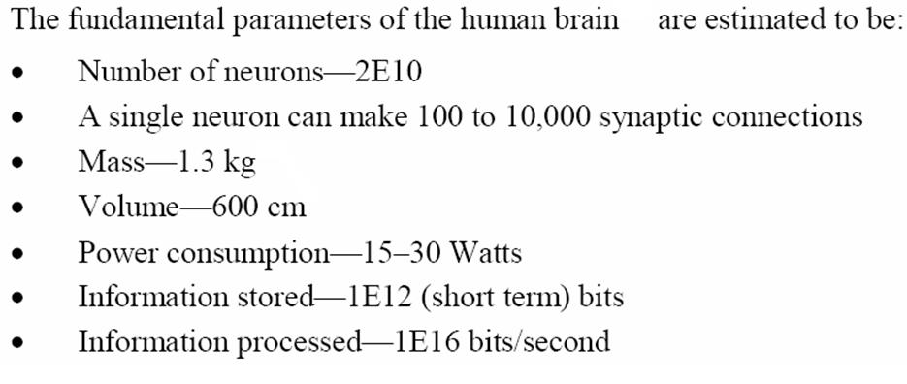
Will these devices make it? The answer is a very definite…..
Maybe!!

Slide 2
Why can’t your pc simply turn on like your television?
MRAM uses magnetism rather than electrical power to store bits of data.

Slide 3
CATEGORIZING STORAGE DEVICES
Storage devices hold data, even when the computer is turned off.
The physical material that actually holds data is called a storage medium. The surface of a floppy disk is a storage medium.
The hardware that writes data to or reads data from a storage medium is called a storage device. A floppy disk drive is a storage device.
The two primary storage technologies are magnetic and optical.

Slide 4
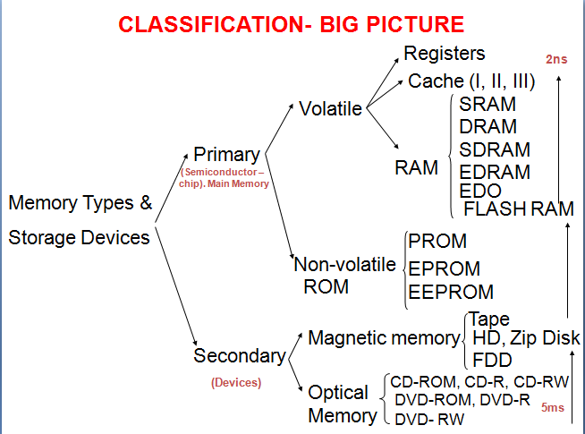

Slide 5
THE PRIMARY TYPES OF MAGNETIC STORAGE ARE:
Diskettes (floppy disks)
Hard disks
High-capacity floppy disks
Disk cartridges
Magnetic tape

Slide 6
THE PRIMARY TYPES OF OPTICAL STORAGE ARE:
Compact Disk Read-Only Memory (CD-ROM)
Digital Video Disk Read-Only Memory
(DVD-ROM)
CD-Recordable (CD-R)
CD-Rewritable (CD-RW)
PhotoCD

Slide 7
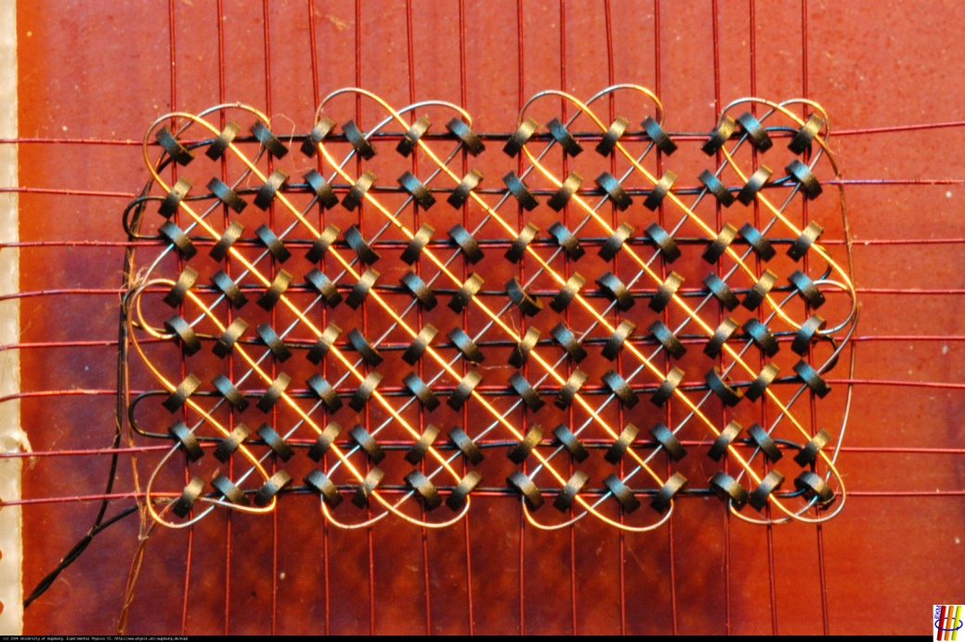
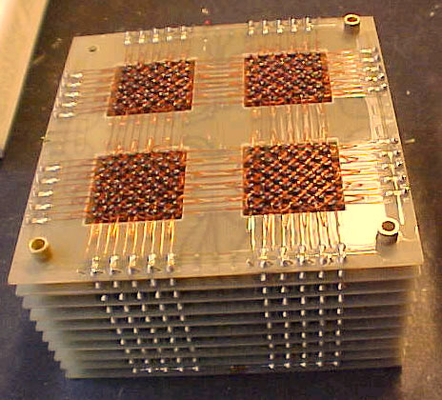
Magnetic Core RAM
By the early 1960’s, Magnetic Core RAM became largely universal as main memory, replacing drum memory

Slide 8
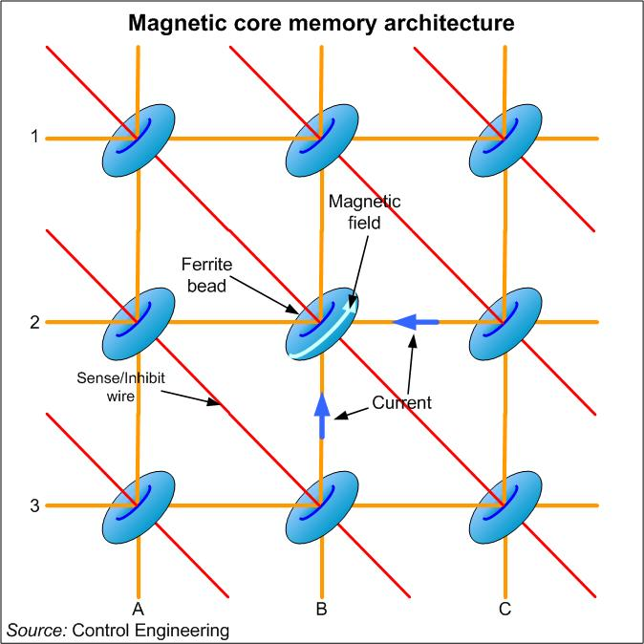
Magnetic Core RAM
The memory cells consist of wired threaded tiny ferrite rings (cores).
X and Y lines to apply the magnetic filed.
Sense/Inhibit line to ‘read’ the current pulse when the polarization of the magnetic field changes.

Slide 9
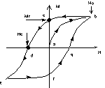
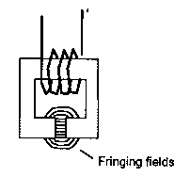
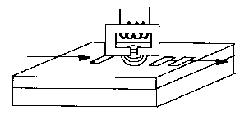
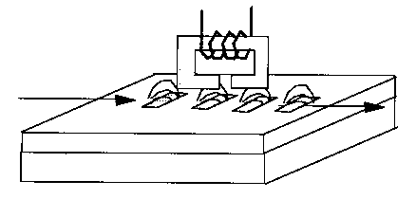
MAGNETIC RECORDING

Slide 10
HOW MAGNETIC STORAGE WORKS
A magnetic disk's medium contains iron particles, which can be polarized—given a magnetic charge—in one of two directions.
Each particle's direction represents a 1 (on) or 0 (off), representing each bit of data that the CPU can recognize.
A disk drive uses read/write heads containing electromagnets to create magnetic charges on the medium.

Slide 11
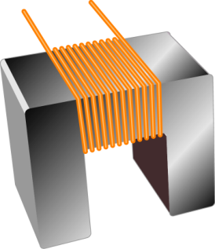

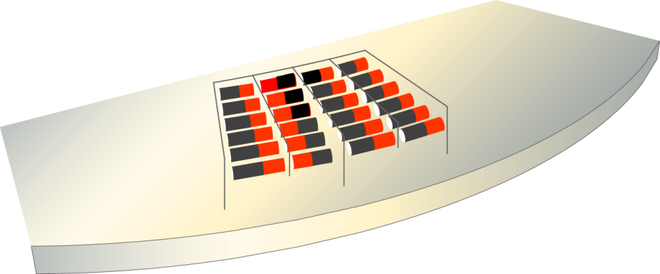
Write head
Medium
Random particles
(no data stored)
Current flow
(write operation)
Organized particles
(represent data)

Slide 12
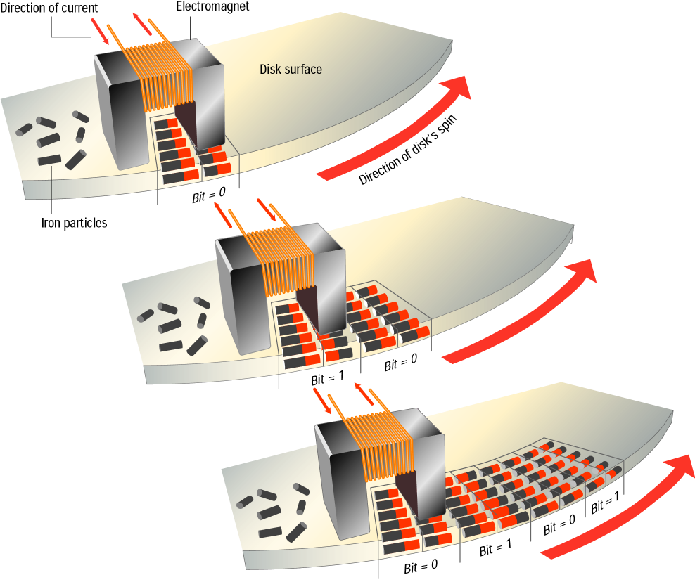
As the medium
rotates, the head
writes the data.

Slide 13
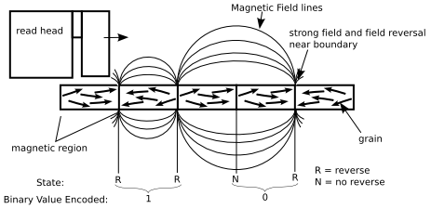
non-volatile memory devices
“Permanent” memory state
Large writing currents required
Density of “grains”, read/write limiting factor

Slide 14
FORMATTING
Before a magnetic disk can be used, it must be formatted—a process that maps the disk's surface and determines how data will be stored.
During formatting, the drive creates circular tracks around the disk's surface, then divides each track into sectors.
The OS organizes sectors into groups, called clusters, then tracks each file's location according to the clusters it occupies.

Slide 15
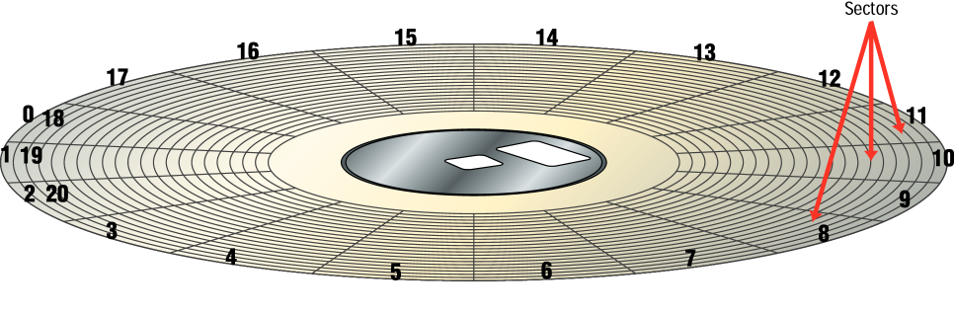
Formatted Disk

Slide 16
DISK AREAS
When a disk is formatted, the OS creates four
areas on its surface:
Boot sector – stores the master boot record, a small program that runs when you first start (boot) the computer
File allocation table (FAT) – a log that records each file's location and each sector's status
Root folder – enables the user to store data on the disk in a logical way
Data area – the portion of the disk that actually holds data

Slide 17
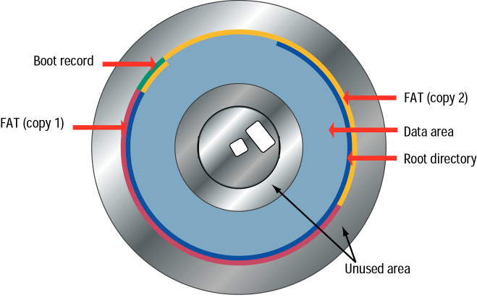

Slide 18
MAGNETIC STORAGE DEVICES - DISKETTES
Diskette drives, known as floppy disk drives, read and write to diskettes (called floppy disks or floppies).
Diskettes are used to transfer files between computers, as a means for distributing software, and as a backup medium.
Diskettes come in two sizes: 5.25-inch and 3.5-inch.

Slide 19
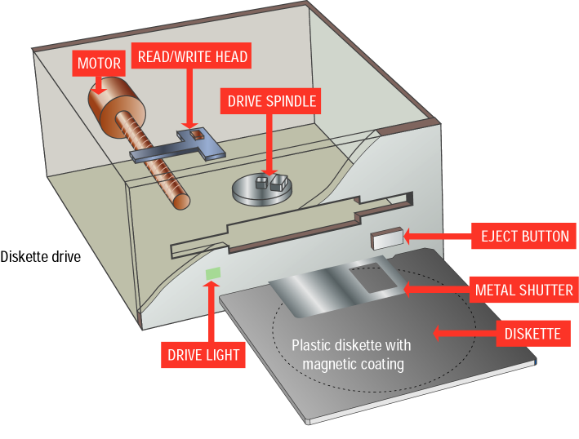
3.5 inch
floppy
and drive

Slide 20
Hard Disk Drive
Purpose:
Long-term, nonvolatile storage
Large, inexpensive, slow level in the storage hierarchy
Disk composition
A magnetic disk consist of a collection of platters (1to 20 per disk) that rotate on a spindle.
Disk surface divided into tracks (1000 to 4800 per platter).
Tracks are divided into sectors (64 per track), which are the smallest unit that can be read or written.
Up to 10,000 rpm

Slide 21
HARD DISKS
Hard disks use multiple platters, stacked on a spindle. Each platter has two read/write heads, one for each side.
Hard disks use higher-quality media and a faster rotational speed than diskettes.
Removable hard disks combine high capacity with the convenience of diskettes.

Slide 22
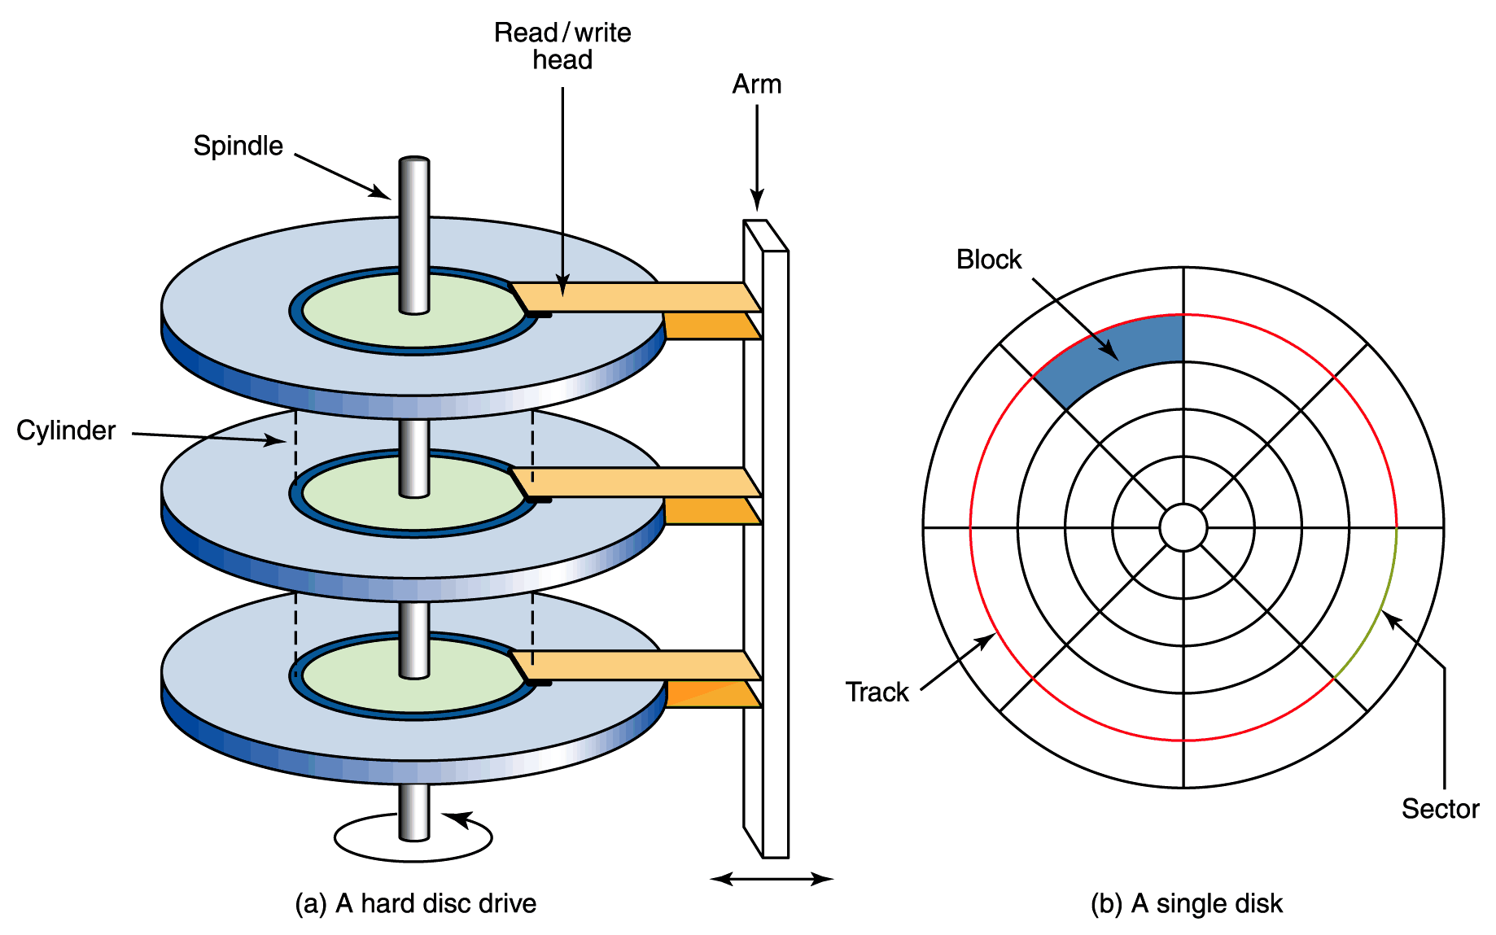
Magnetic Disks
A read/write head travels across a spinning magnetic disk, retrieving or recording data
The organization of a magnetic disk

Slide 23
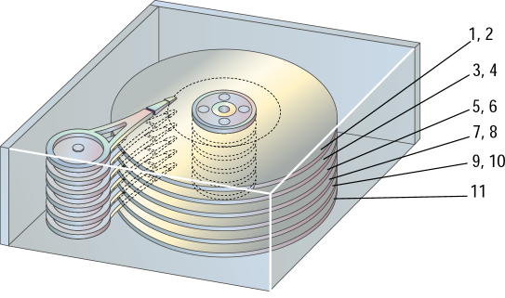
Read/write heads

Slide 24
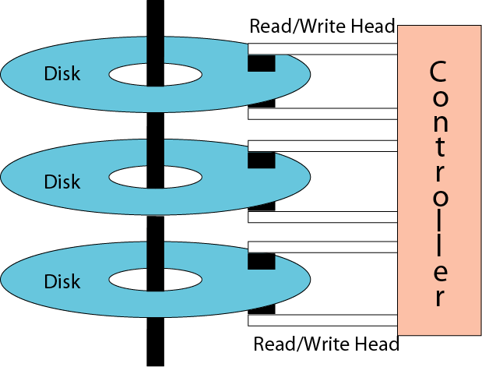
Physical layout of a magnetic disk

Slide 25
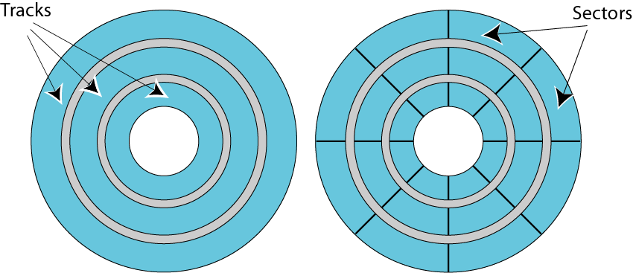
Surface organization of a disk

Slide 26
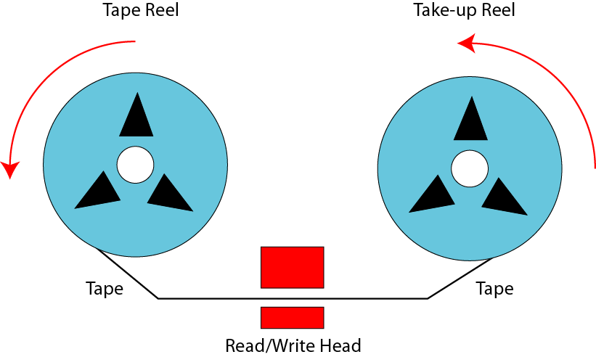
Mechanical configuration of a tape

Slide 27
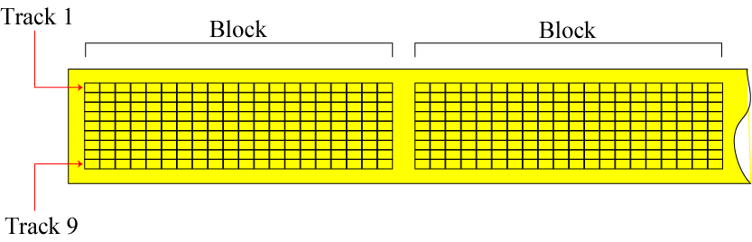
Surface organization of a tape

Slide 28
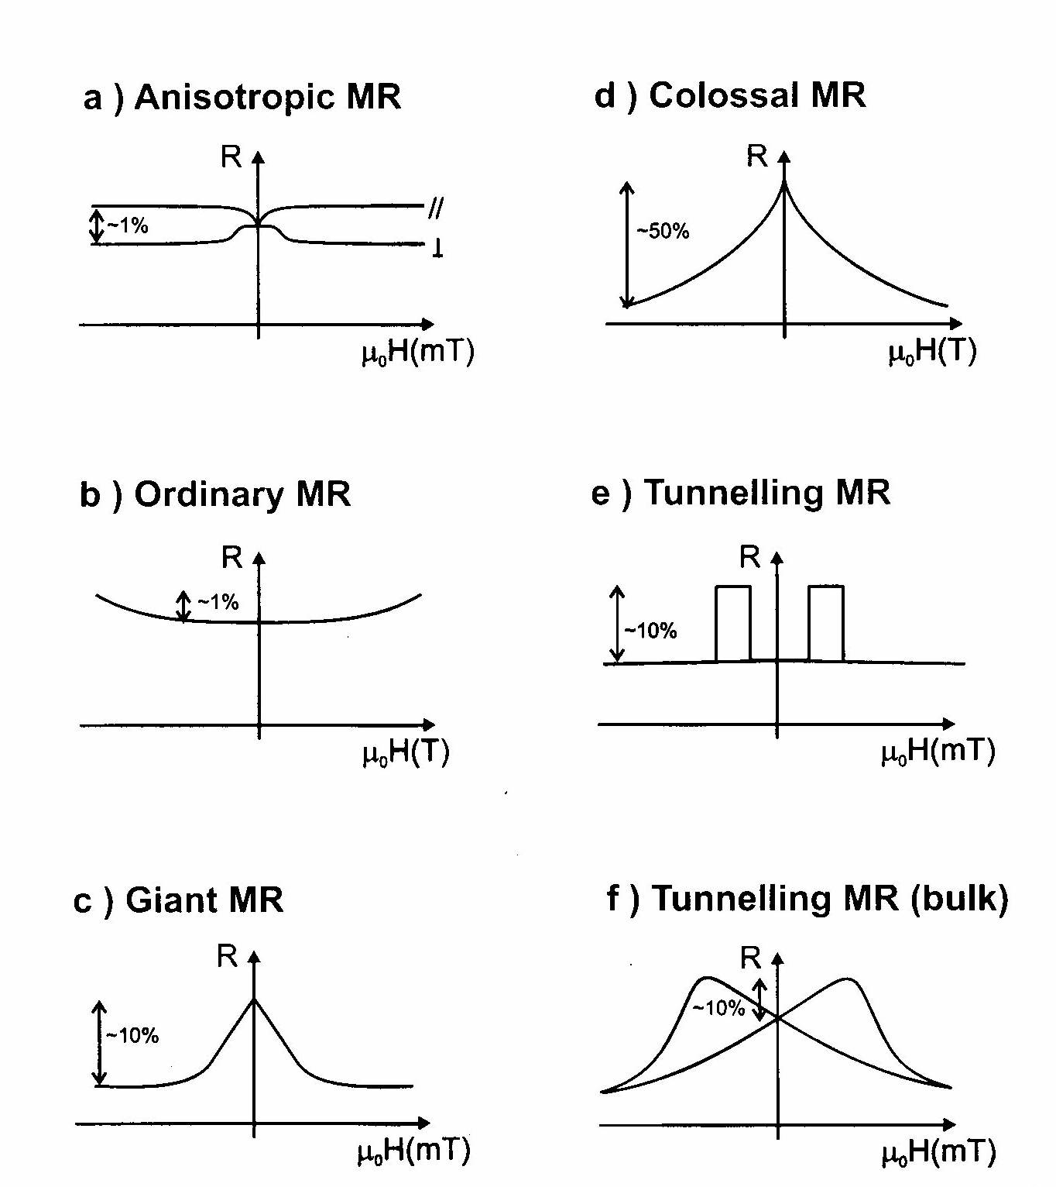

Slide 29
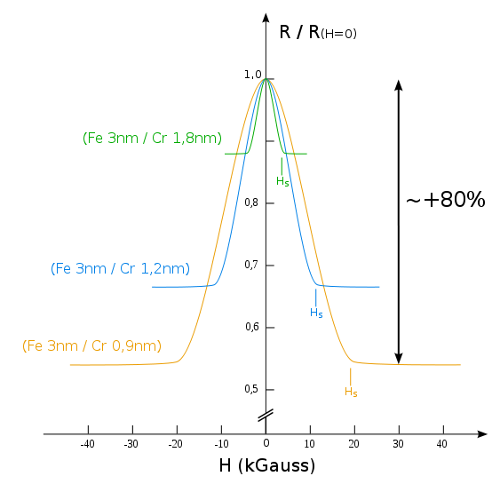
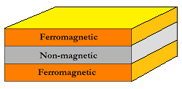
Giant Magnetoresistance (GMR)
Two thin films of altering ferromagnetic materials and a non-magnetic layer-spacer.
10-80% decrease in electrical resistance

Slide 30
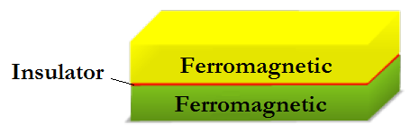
Tunnel Magnetoresistance (TMR)
Two thin films of altering ferromagnetic materials and an insulating spacer.
Fe/MgO/Fe junctions reach over 200% decrease in electrical resistance at room temperature
600 (room temperature)-1100 (4.2 K) % TMR at junctions of CoFeB/MgO/CoFeB

Slide 31
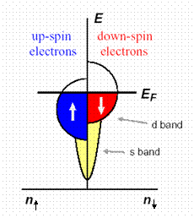
Tunnel Magnetoresistance (TMR)
In ferromagnetic metals electronic bands are exchange split which implies different densities of states at the Fermi energy for the up- and down-spin electrons.

Slide 32
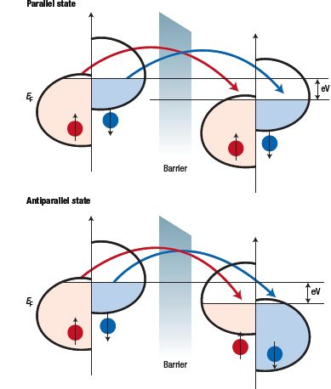
Tunnel Magnetoresistance (TMR)
Spin of electrons is conserved in the tunneling process.
Tunneling of up- and down-spin electrons are two independent processes → conductance occurs in the two independent spin channels.
Electrons originating from one spin state of the first ferromagnetic film are accepted by unfilled states of the same spin of the second film.

Slide 33
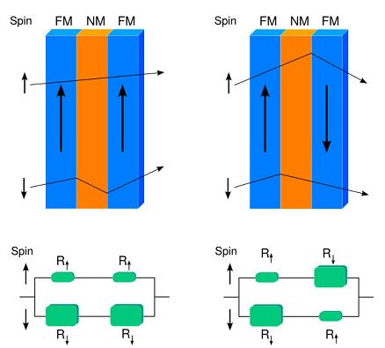
Spin Valve GMR
Hard layer: magnetization is fixed.
Soft layer: magnetization is free to rotate.
Thin non-ferromagnetic spacer ~3 nm.
Spacer material Cu (copper) and ferromagnetic layers NiFe (permalloy).
This configuration used in hard drives.

Slide 34
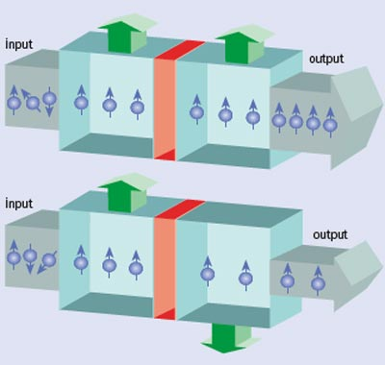
Magnetic Tunnel Junction (MTJ)
Commonly used insulating materials are Aluminum oxide (Al₂O₃) and crystalline Magnesium oxide (MgO)

Slide 35
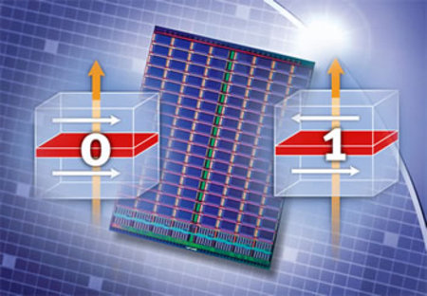
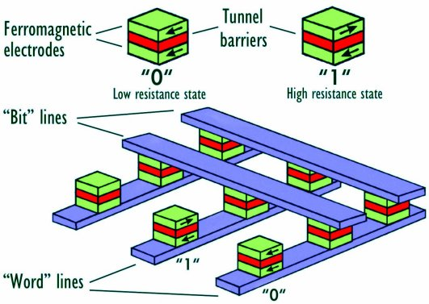
MRAM
One of the two plates is a permanent magnet set to a particular polarity, the other's field will change to match that of an external field.

Slide 36
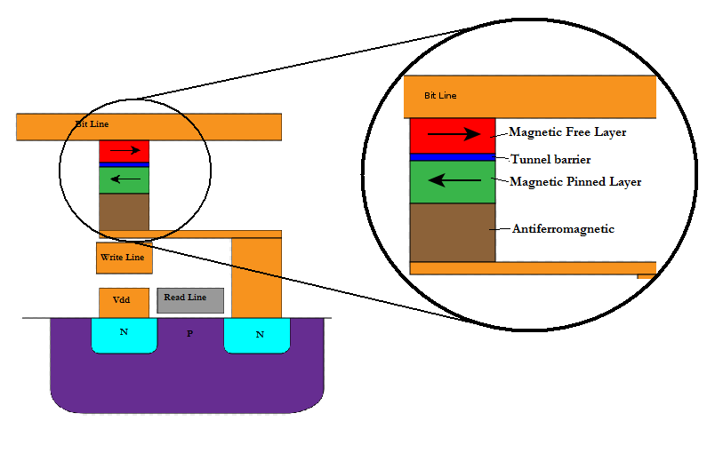
MRAM: Fixed layer
The bottom layers give an effect of fixed (pinned) layer due to interlayer exchange coupling between ferromagnetic and spacer layer of synthetic antiferromagnetic.

Slide 37
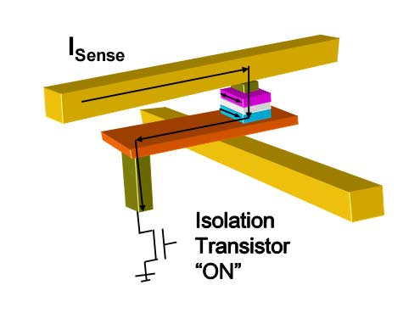
MRAM: Reading process
Transistor is “ON”
Measuring of electrical resistance of a small sense current from a supply line through the cell to the ground.

Slide 38
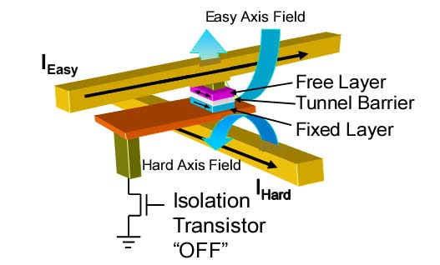
MRAM: Writing process
Transistor is “OFF”
When current is passed through the write lines, an induced magnetic field is created at the junction, which alters the polarity of the free layer.

Slide 39
MRAM: Writing process
In order to change the polarity of the free layer, both fields are necessary.
Only the bit in which current is applied in both hard and easy axis will be written. The other bits will remain half-select.

Slide 40
MRAM: Characteristics
Non-volatility
Infinite endurance
High speed performance
Low cost

Slide 41
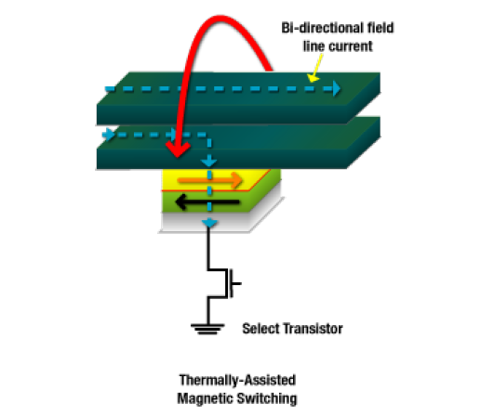
Future MRAM Improvements
Thermal Assisted Switching
Solves the first-generation selectivity and stability problems
Cost-effective and scalable memory technology to at least the 32nm node

Slide 42
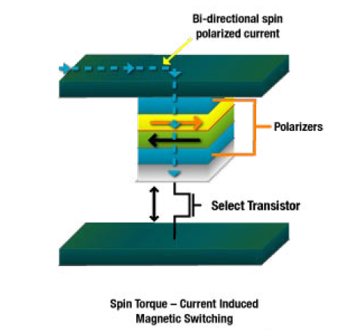
Future MRAM Improvements
Spin Torque Transfer
No applied magnetic field
Utilizes heavily spin polarized current
The magnetization of nano-elements is flipped back and forth
Still has challenges in basic physics and materials to overcome

Slide 43
MRAM Status
2003 - A 128 kbit MRAM chip was introduced, manufactured with a 180 nm lithographic process
2004 - Infineon unveiled a 16-Mbit prototype, manufactured with a 180 nm lithographic process
2005 - Sony announced the first lab-produced spin-torque-transfer MRAM
2007 - Tohoku University and Hitachi developed a prototype 2 Mbit Non-Volatile RAM Chip employing spin-transfer torque switching
2008 - Scientists in Germany have developed next-generation MRAM that is said to operate with write cycles under 1 ns.
2009 - Hitachi and Tohoku University demonstrated a 32-Mbit spin-transfer torque RAM (SPRAM) and so on….

Slide 44
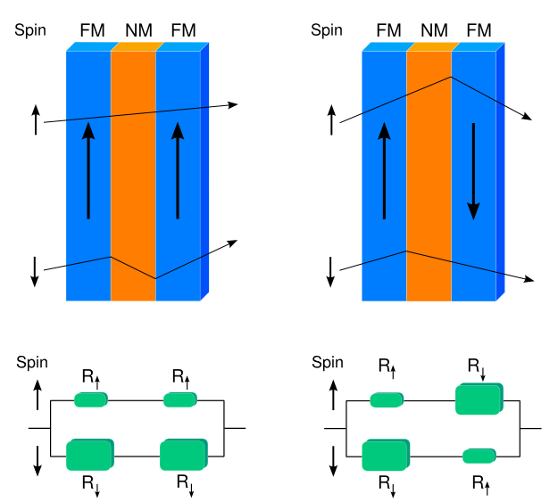
SPINTRONICS THE SOLUTION
Carrier spin used as two state device ( )
Able to integrate computing and memory into one device utilizing charge/spin.
GMR spin-valves

Slide 45
Optical storage devices
CD-ROM: compact disc ROM (Read Only Memory)
Capacity: 650MB
CD-R: compact disc recordable
CD-RW: compact disc rewritable
DVD: digital versatile disc
Capacity: 4.7GB – 17GB
DVD-R
DVD-RW
An optical disk is a high-capacity storage medium. An optical drive uses reflected light to read data.
To store data, the disk's metal surface is covered with tiny dents (pits) and flat spots (lands), which cause light to be reflected differently.
When an optical drive shines light into a pit, the light cannot be reflected back. This represents a bit value of 0 (off). A land reflects light back to its source, representing a bit value of 1 (on).

Slide 46
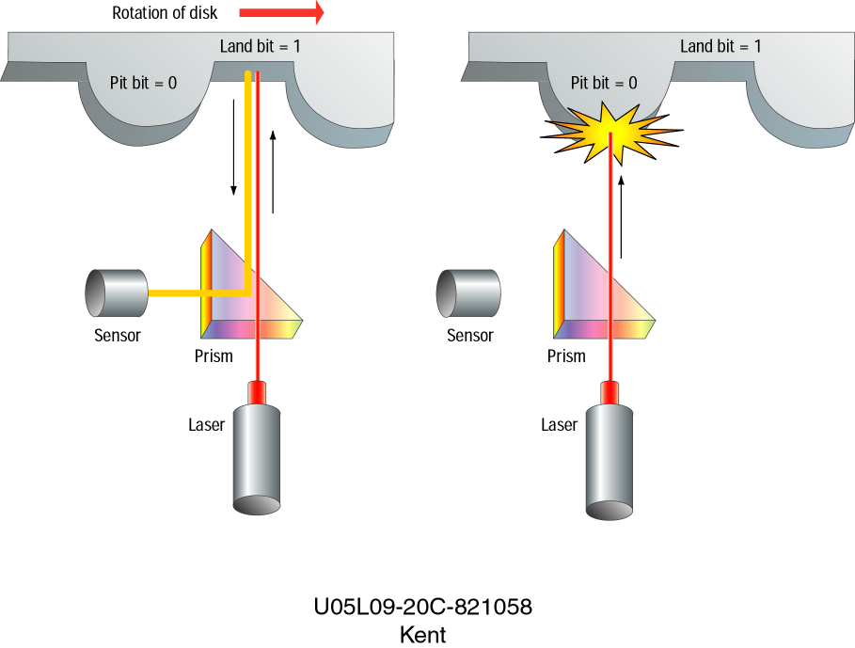
1
0

Slide 47
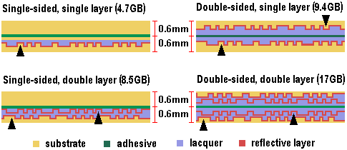
DVD (Digital Versatile Disk)
Allows up to 17 gigabytes of storage (from 4.7 GB to 17 GB).
Compatible with older CD-ROM technology.
The four versions of the DVD:

Slide 48
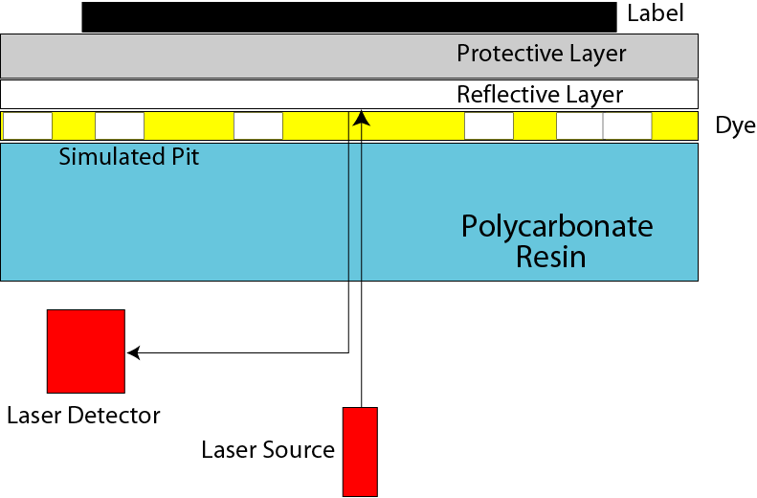
Making a CD-R

Slide 49
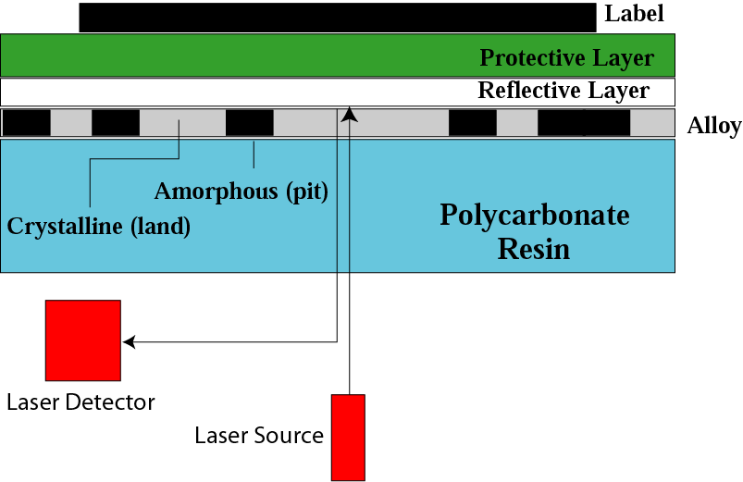
Making a CD-RW

Slide 50
Magneto Caloric Effect (MCE)
1. The magnetocaloric effect (MCE) is defined as the adiabatic change in sample temperature or equivalently as the isothermal change in entropy with the application of a magnetic field.
2. When a dc magnetic field is applied to a solid, which is thermally isolated from its surroundings, a change of the temperature of the solid may be observed. This phenomenon is known as magnetocaloric effect or, more precisely, the adiabatic temperature change due to a change of the applied magnetic field.
3. The MCE was first discovered about 120 years ago by Warburg, when he observed heat evolution in iron under the varying external magnetic field. At the beginning of the last century Langevin (1905) clearly demonstrated for the first time that the change in the magnetization of a paramagnet would generally result in a reversible temperature change.

Slide 51
Magneto Caloric Effect and Magnetic Transition
The magnetocaloric effect can give valuable information about the nature of magnetic ordering. In the case of a paramagnet and a ferromagnet, the magnetocaloric effect (ΔT_{ad}) is positive i.e. with the application of magnetic field under adiabatic conditions sample temperature increases.
When a magnetic field is applied to a paramagnetic or a ferromagnetic material, magnetic moments get oriented preferentially in the magnetic field direction. As a result magnetic entropy decreases with the application of magnetic field. Since under adiabatic condition, the total entropy of the system remains constant, it results in the increase of lattice entropy i.e. increase in sample temperature.
For an antiferromagnet, in the presence of external magnetic field, entropy associated with the magnetic sublattice antiparallel to field direction increases. The net result of the application of external magnetic field is the increase in magnetic entropy, as a result sample temperature decreases in this case. This is true provided spins are not flipping along the field direction.

Slide 52
MCE is proportional to the rate of change of magnetization, which is maximum around the magnetic transition temperature. This is because around magnetic ordering temperature, the application of a magnetic field under isothermal condition produces a larger change in magnetization than at higher or lower temperature.
Thus the magnitude of magnetocaloric effect is maximum near the magnetic transition temperature.
Above the magnetic transition temperature the magnetic moments are oriented randomly. With increasing temperature the thermal effect on the randomness of magnetic moments increases. As a result the external magnetic field will produce only paramagnetic response and the magnetocaloric effect decreases with increasing temperature.
At temperatures much lower than the transition temperature, the magnetization can not change significantly, as the external magnetic field will have small effect compared to strong exchange interaction. Thus the magnetocaloric effect for ferromagnetic systems shows a positive caret like shape with a maxima around the ordering temperature and for antiferromagnetic systems, it will be negative caret like shape with minima around the magnetic ordering temperature

Slide 53
Due to large magnetic moment of rare earths, the compounds with rare earth are potential candidates for large magnetocaloric effect.
Compound | T_{C} (K) | Magnetocaloric Effect
 |  | T_{max} (K) | ΔH (kOe) | ΔT_{ad} (K) | -ΔS (J/mol K)
DyAl₂ | 63.3 | 63.9 | 75 | 9.18 | 3.2
ErAl₂ | 13 | 13.6 | 75 | 14.26 | 4
Dy_{0.5}Er_{0.5}Al₂ | 37.8 | 38.2 | 75 | 10.46 | 6.4
GdPd | 38 | 38 | 70 | 8.7 | 3.4 (75 kOe)
Er₃AlC | 5.5 | 5 | 75.3 | 12.8 | 7.6 (75 kOe)
TbNi₂ | 37 | 38 | 75.3 | 11 | 3.6 (75 kOe)
GdNi₂ | 75 | 75 | 70 | 5.9 | -
DyNiAl | 29 | 31 | 75.3 | 6.3 | 2.2 (75 kOe)
ErNiAl | 5.6 (T_{N}) | 8 | 50 | 6 | -
Gd_{0.2}Er_{0.8}NiAl | 11 21 | 14 | 50 | 6.8 | -
Gd_{0.4}Er_{0.6}NiAl | 9 32 | 22 | 50 | 6.2 | -
GdNiAl | 23 58 | 58 | 50 | 4.1 | -
Gd₅Si₂Ge₂ | 276 299 | 280 | 50 | 16 | 18

Slide 54
METHODS OF DETERMINING THE MAGNETOCALORIC EFFECT
Magnetocaloric effect (ΔT_{ad}, ΔS) of a material can be obtained by
(1) direct measurements (Gives ΔT_{ad} only)
(2) magnetization measurements (Gives ΔS only) and
(3) heat capacity measurements (Gives both ΔT_{ad} and ΔS).

Slide 55
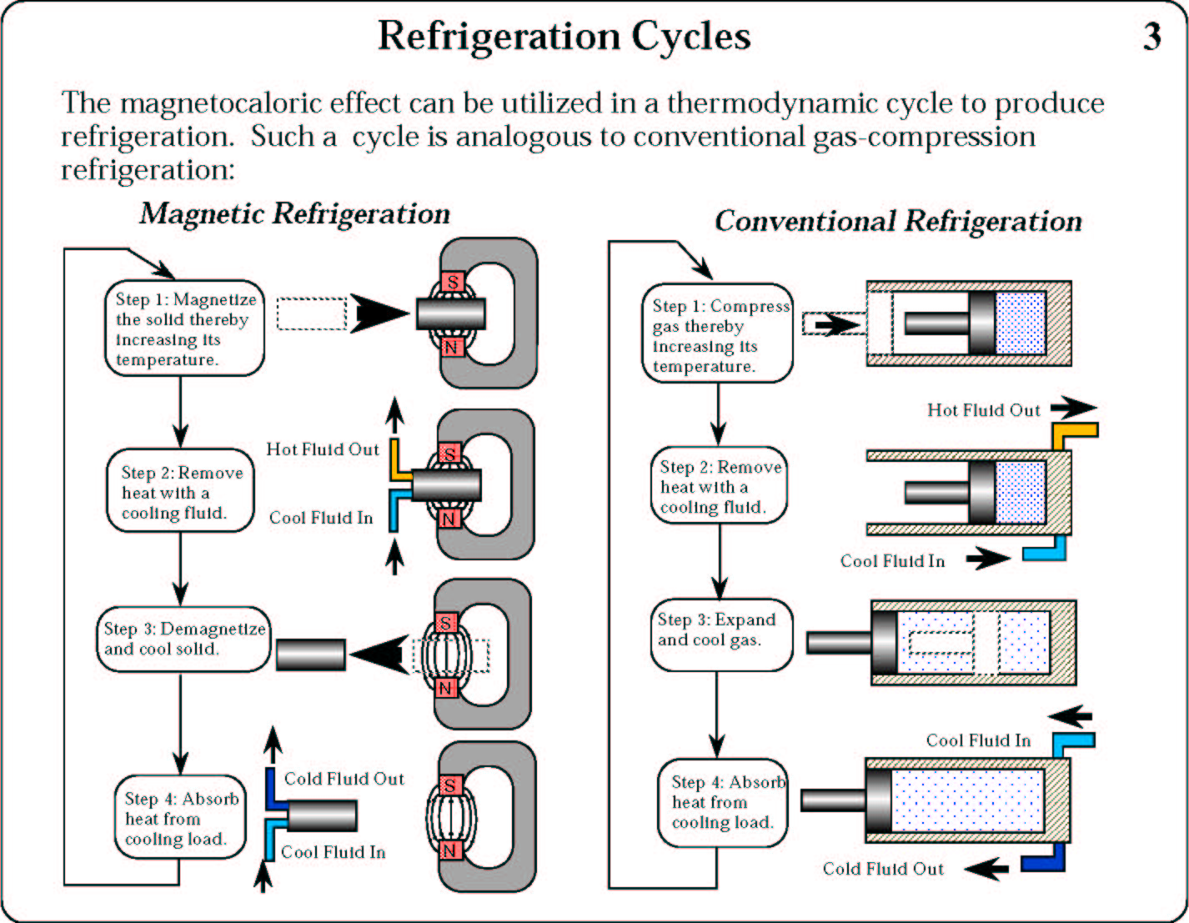

Slide 56
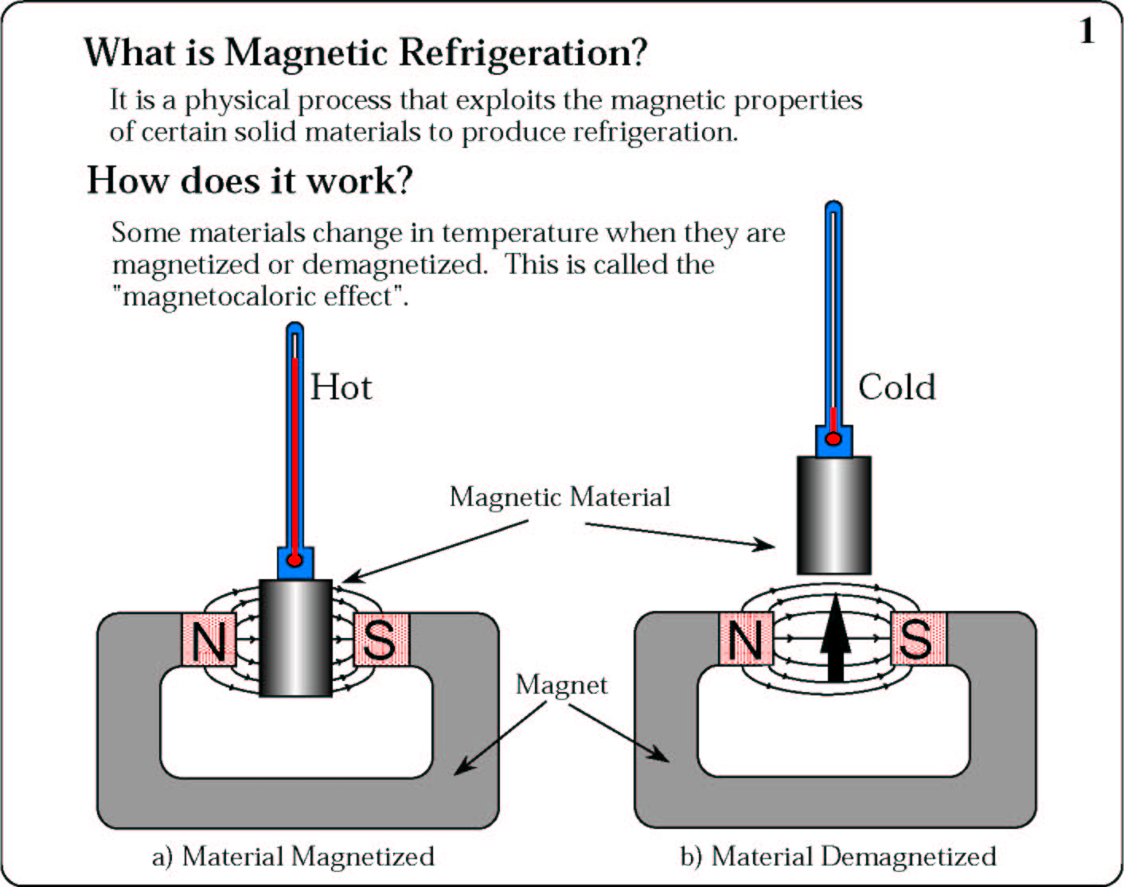
Magnetic Refrigeration
Nature 2.73K Laboratory 2μK

Slide 57
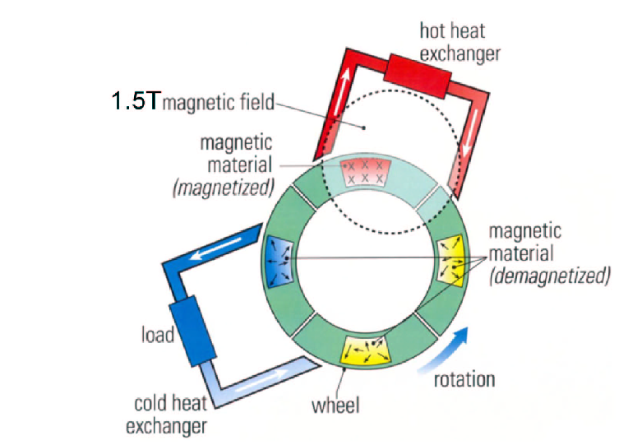

Slide 58
